Slide 1

Unit 12

Slide 2
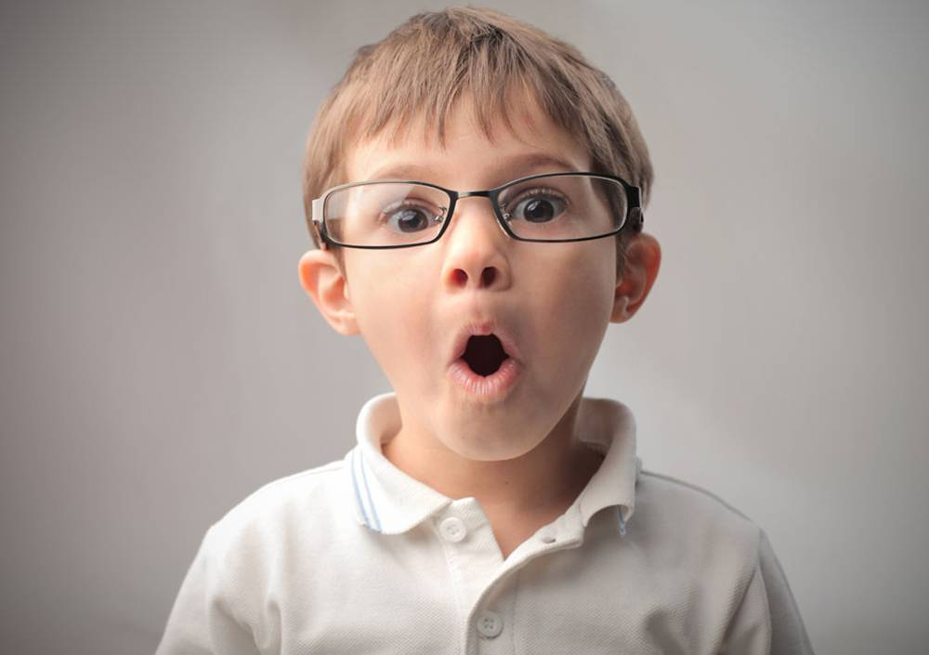
Unit 12
Life is full of the unexpected.

Slide 3
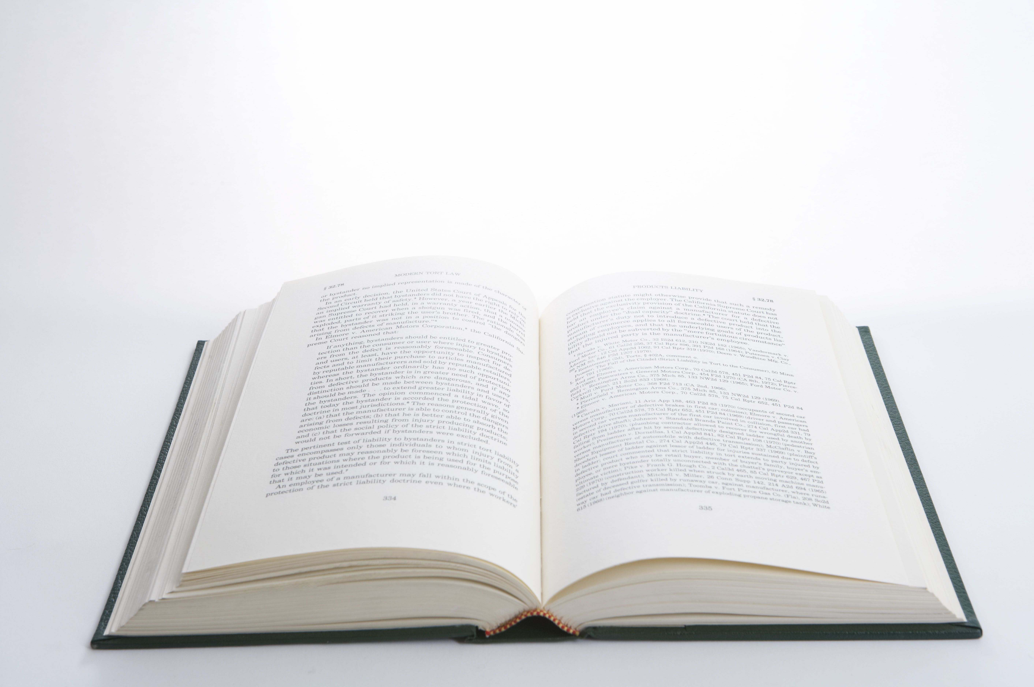


Slide 4


Try to retell the four stories (Passage 2b) with the help of the table.

Slide 5
Time | Place | Trick | Result
On ______ ___________ | In England | There would be _____________ _________. | All of the spaghetti was ________.
On _______ ___________ | In _______ | The special water would help people ___________. | More than 10,000 people __________________________ ____________.
On April Fool’s Day |  | A famous TV star asked his girlfriend _____________. | The TV star lost ____________ ____________.
In ________, 1983 | In _______ | ________ landed on the earth. | Thousands of people ______ _____________.
April
Fool’s Day
no more
spaghetti
sold out
April
England
Fool’s Day
phoned the TV station to get the water
lose weight
his girlfriend
and his show
to marry him
October
America
Aliens
had
left their homes
Notes:
5

Slide 6


1. To learn to write a passage about
your lucky or unlucky day
2. To finish Self Check.

Slide 7


Can you remember a lucky or an unlucky day? What happened? Make some notes about what you remember.
3a

Slide 8
What was the date?
What happened first?
Was this lucky or unlucky? Why?
What happened next?
How did the day end?
How did you feel about this day?

Slide 9

Write a story about your lucky or unlucky day and tell your story to a partner or the class.
3b

Slide 10
My lucky/unlucky day
I will always remember the date…
This was the luckiest/ unluckiest day of my life…
When I woke up that morning…
Later that day,…
I couldn’t believe…
Then/ After that,…
Finally,…
I think…
What a lucky/ an unlucky day!

Slide 11
【写作任务】
请以“My lucky day”为题，写一篇英语短文，记叙你经历过的幸运的一天，讲讲那天都发生了些什么事情，然后给某中学生英文杂志的“Your Voices”专栏投稿。

Slide 12
【思路点拨】
1. 定基调
体裁：记叙文
时态：过去时态
人称：第一人称和第三人称
2. 谋布局、写句子

Slide 13
谋布局 |  | 写句子
开篇点题 |  | I will always remember the date September 14th, 2019. This was the luckiest day of my life.
阐述经历 | 幸运 事件1 | When I woke up that morning, it was raining. (1)___________________________ _____________________________________ _____________________________________ (我正要去公交车站坐车去上学，这时我叔叔打来了电话). (2)___________________________________________________(我叔叔说他可以捎我一程).
I was about to go to the bus station to take the bus to school when my uncle called me up
My uncle said (that) he could give me a lift in his car

Slide 14
谋布局 |  | 写句子
 | 幸运 事件2 | (3)Later that day, ________________________ _________________________ (我意识到我把钱包忘在家里了) and couldn’t buy lunch. My best friend Lisa said she could share her lunch with me. (4)_________________________(我吃了一顿免费的午餐).
 | 幸运 事件3 | After that, I was praised by my math teacher. (5)_____________________________________ (我数学考试得了最高分). I couldn’t believe that I did so well, and neither could my parents.
I realized (that) I had left my wallet at home
I had / ate a free lunch
I got the highest score in the math exam

Slide 15
谋布局 |  | 写句子
 | 幸运 事件4 | (6)That night my parents were so happy that _________________________________ ________________________ (他们答应我将给我买一辆自行车作为奖励).
总结感慨 |  | I think that was the best day I’d had in a long time. What a lucky day!
they promised me that they would buy a bike for me as a prize

Slide 16
3. 巧衔接
在连句成篇时，前后句之间有因果关系，可以用because或so来连接。
此外，在阐述经历时，本文使用了表示时间顺序的表达 (如When I woke up that morning ..., Later that day ..., After that ... 和That night ...) 将几件幸运的事情串联起来，这样做使得上下文之间联系更紧密，文章的脉络更清晰。

Slide 17
4. 成篇章
My lucky day
I will always remember the date September 14th, 2016. This was the luckiest day of my life.
When I woke up that morning, it was raining. I was about to go to the bus station to take the bus to school when my uncle called me up. He said he could give me a lift in his car. Later that day, I realized I had left my wallet at home and couldn’t buy lunch. My best friend Lisa said she could share her lunch with me, so I had a free lunch.

Slide 18
After that, I was praised by my math teacher because I got the highest score in the math exam. I couldn’t believe that I did so well, and neither could my parents. That night they were so happy that they promised me that they would buy a bike for me as a prize.
I think that was the best day I’d had in a long time. What a lucky day!
Share your stories!

Slide 19

rush to ...
more than
run away from
on the first day of school
turn around
hand in
匆忙去……
超过；多于
逃离
在上学第一天
转向；回转
上交

Slide 20

Self Check
1. Read the words in the box. Make sure you know the meaning of the words.
2. Complete the passage with the correct form of each word in the box.

Slide 21
cancel miss west accident
lady officer market unexpected
Last Saturday after my French course, I decided to drive to the ________ to buy a meat pie for dinner. As I was heading ______, I saw a huge truck in the middle of the road.
There had been a(n) ________ and there were many police _______ around. I turned around and decided to go to a nearby mall.
market
west
accident
officers

Slide 22
cancel miss west accident
lady officer market unexpected
However, I _______ the road that led to the mall. Then I saw a restaurant that sold chicken noodles. I went inside and the _____, who was the owner, served me the most delicious bowl of chicken noodles ever. I had made a(n) ___________ discovery! I’m so glad that I _________ my plan to go to the market.
missed
lady
unexpected
cancelled

Slide 23
2. Think of ways to finish the answers.
1. A: Why didn’t you hand in your science
homework?
B: Before I could start working on it,
________________________________
________________________________
________________________________.
my baby brother started crying and I had to look after him because my mother was sick

Slide 24
2. A: Why didn’t you take a shower this
morning?
B: By the time I got up, ____________
______________________________
______________________________
____________.
my sister had already gone into the bathroom and the bus was honking (鸣喇叭) for me to hurry up

Slide 25
3. A: Why did you have to walk home
from school?
B: By the time I left my school,
____________________________.
the school bus had already left
Any possible answer is OK!

Slide 26


根据短文内容及所给首字母提示，补全文中所缺单词，使短文完整、通顺。
Bert is my best friend. Bert is honest so everyone trusts him. In other words, Bert is a b__________ (1) boy.
Last Sunday his mom's new friend Claire came to see her. Because his mom was busy, she asked Bert to meet Claire. On Saturday evening, Bert went to bed late.
believable

Slide 27
On Sunday morning his alarm clock didn't r__________ (2) and his mom didn't wake him up before going to work, so Bert o_________ (3). Bert didn't get up t__________ (4) half past nine. He hurried to the airport by taxi. On the way, he had an u__________ (5) accident. Luckily, he wasn't hurt. But a young l_______ (6) in another taxi was hurt and was sent to hospital.
ring
overslept
till
unexpected
lady

Slide 28
When Bert finally got to the airport, he couldn't find Claire. He called his mom, and then his mom called Claire. Guess what happened? Claire was in hospital! The taxi that Bert was riding in hit the taxi that Claire was riding in!

Slide 29


1. Revise your composition.
2. Preview the new words and expressions in Unit 13.
3. Preview 1a-2d on P97-98.

Slide 30


